Slide 1
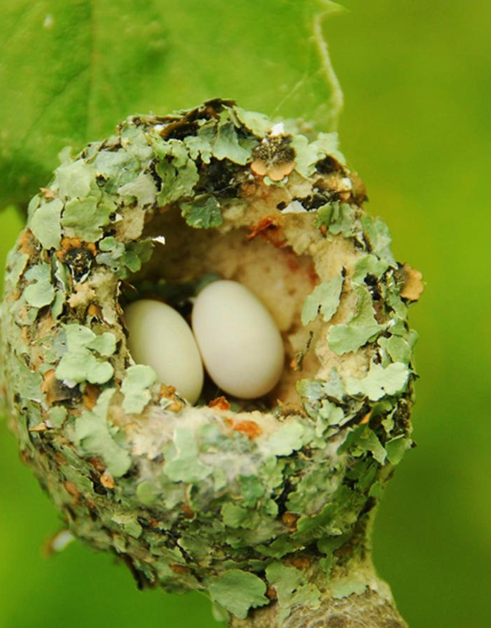
STAKEHOLDERS WORKSHOP –AML /CFT LEGAL FRAMEWORK
JOSEPH OWUOR– SENIOR SUPERVISION OFFICER
27TH AUGUST 2020

Slide 2
Presentation Outline
Introduction
The Proceeds of Crime and Anti-Money Laundering Act, 2009 (POCAMLA) and regulations
Prevention of Terrorism Act, 2012 (POTA) and regulations
Revised AML/CFT guidelines – Key provisions
Conclusion

Slide 3
INTRODUCTION
Kenya’s AML/CFT legal and institutional framework
The Proceeds of Crime and Anti-Money Laundering Act 2009 (POCAMLA) and POCAMLA Regulations 2013
The Prevention of Terrorism Act 2012 (POTA and POTA Regulations 2013
IRA AML/CFT Guidelines 2011 revised 2018 and other guidelines issued by other regulators
International AML/CFT Standard Setting Bodies
The FATF 40 Recommendations on ML and 9 special recommendations on TF
FATF-Style Regional Bodies (FSRBs) – ESAAMLG,

Slide 4
INTRODUCTION
The Purpose of the two Acts (POCAMLA & POTA);
(a) provide for the offence of money laundering and to introduce measures for combating the offence;
(b) to provide for the mechanism for identification, tracing, freezing, seizure and confiscation of the proceeds
(c) measures for the detection and prevention of terrorist activities;
The legislations have generally provided for the responsibilities of financial institutions or the reporting institutions
The Authority has formulated its AML/CFT guidelines based on the provisions of the above legislations;
Guidelines customizes the provisions of the laws and regulations made under them to specific issues relevant to the Industry.

Slide 5
The Insurance (AML/CFT) Guidelines 2020
Key Provisions
The Key Provisions relates to the following areas;
Object of the guidelines
Application of the guidelines
General requirements for regulated entities
Responsibilities of the board of a regulated entity
Responsibility of senior management of a regulated entity
Money Laundering Reporting Officers
IRA© 2016

Slide 6
The Insurance (AML/CFT) Guidelines 2020
Key Provisions
The Key Provisions relates to the following areas;
7. Functions of the money laundering reporting officer
8. Access to information
9. Independent Audits
10. Anti-money laundering and combating financing of terrorism programme
11. Elements of anti-money laundering and combating financing
IRA© 2016

Slide 7
The Insurance (AML/CFT) Guidelines 2020
Key Provisions
The Key Provisions relates to the following areas;
12. Key operational controls of an anti-money laundering and combating financing of terrorism policy
13. Compliance policy statement and the contents
14. Staff vetting and training
15. Customer Risk assessment and Customer Due Diligence
16. Reliance on intermediaries for customer due diligence
17. Reliance on intermediaries for customer due diligence
IRA© 2016

Slide 8
The Insurance (AML/CFT) Guidelines 2020
Key Provisions
The Key Provisions relates to the following areas;
18. Suspicious transactions, reporting and the triggers
19. Reporting on cash transactions.
20. Database on United Nations Sanctions List
21 . Compliance and Enforcement
IRA© 2016

Slide 9
Thank you
Joseph Owuor
Senior Supervision Officer,
Insurance Regulatory Authority
www.ira.go.ke
jowuor@ira.go.ke
+254 719 047 249
Notes:
Thanks for your attention.

